Slide 1
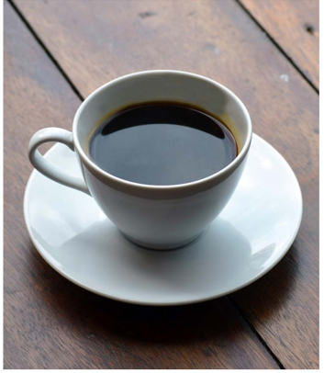
7 Steps to Make Coffee
Place coffee filter in the basket
Measure coffee grounds
Measure water
Turn on coffee maker
Let coffee brew
Pour a cup
Enjoy!

